Slide 1

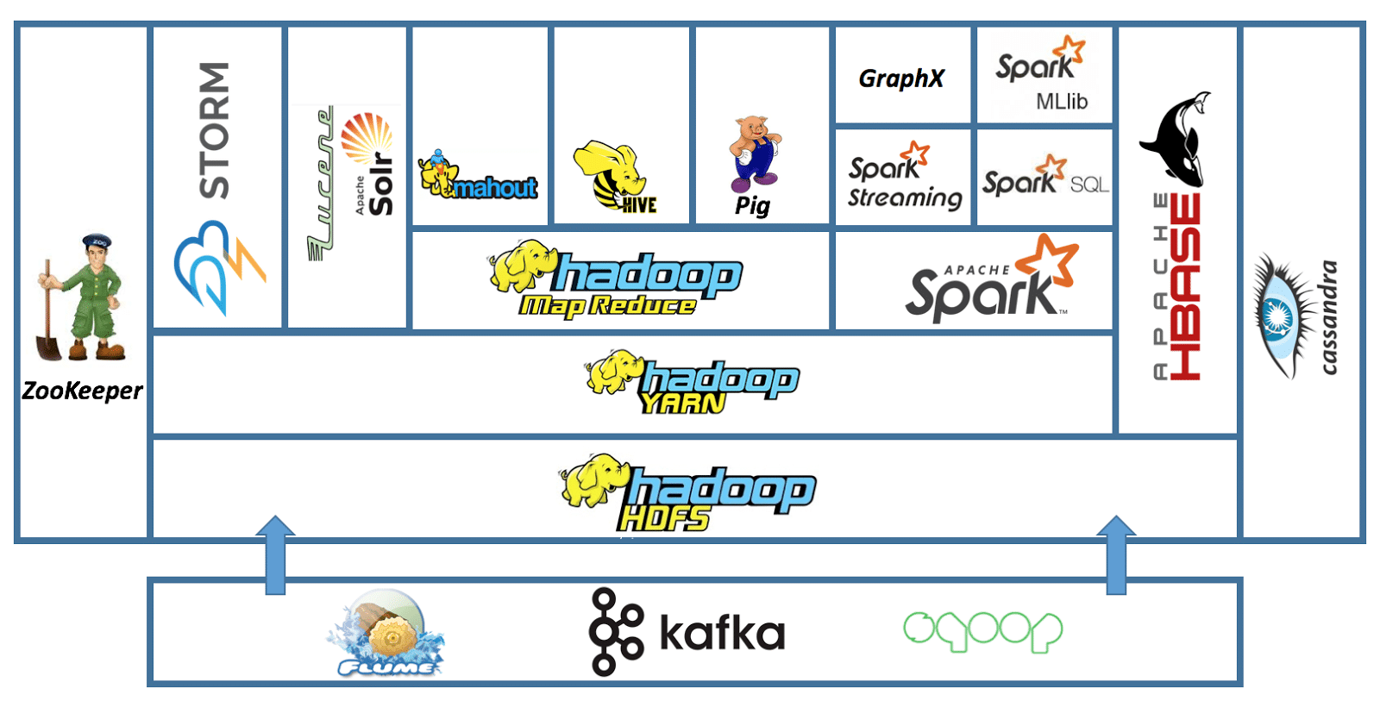
Lab 04 - Apache Hadoop
https://bit.ly/3HDBgbA

